Slide 1
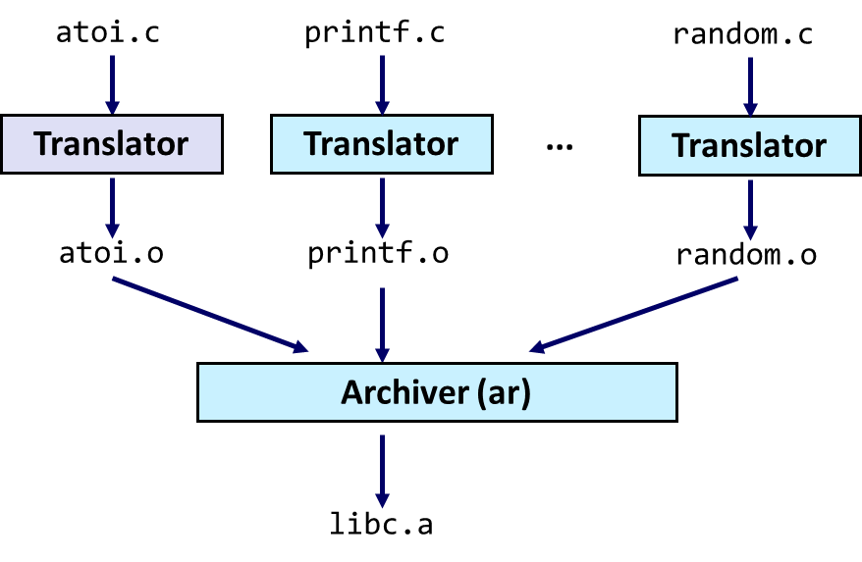
The Runtime Environment Libraries

Slide 2
The Runtime Environment
Part I: Life Cycle of a Program, Overview
Part II: Symbol Resolution and Relocation
Part III: Libraries

Slide 3
Module Overview
Part III - Libraries
Static and Dynamic Libraries
Dynamic Linking
Position-Independent Code
Library Interpositioning
Overview

Slide 4
Static and Dynamic Libraries

Slide 5
Packaging Commonly Used Functions
How to package functions commonly used by programmers?
Math, I/O, memory management, string manipulation, etc.
Two strawman’s approaches:
Option 1: Put all functions into a single source file
Programmers link big object file into their programs
Space and time inefficient
Option 2: Put each function in a separate source file
Programmers explicitly link appropriate binaries into their programs
More efficient, but burdensome on the programmer

Slide 6
Solution: Static Libraries
Static libraries (.a archive files)
Concatenate related relocatable object files into a single file with an index (called an archive).
Enhance linker so that it tries to resolve unresolved external references by looking for the symbols in one or more archives.
If an archive member file resolves reference, link it into the executable.

Slide 7
Creating Static Libraries
atoi.c
printf.c
random.c
Translator
Translator
...
Translator
atoi.o
printf.o
random.o
Archiver (ar)
$ ar rs libc.a \
atoi.o printf.o … random.o
libc.a
C standard library
Archiver allows incremental updates
Recompile function that changes and replaces .o file in archive.

Slide 8
Commonly Used Libraries
libc.a (the C standard library)
6 MB archive of 2055 object files (glibc 2.35)
I/O, memory allocation, signal handling, string handling, data and time, random numbers, integer math
libm.a (the C math library)
1 MB archive of 795 object files.
floating point math (sin, cos, tan, log, exp, sqrt, …)
% ar -t /usr/lib/libc.a | sort
…
fork.o
…
fprintf.o
fpu_control.o
fputc.o
freopen.o
fscanf.o
fseek.o
…
% ar -t /usr/lib/libm.a | sort
…
e_acos.o
e_acosf.o
e_acosh.o
e_acoshf.o
e_acoshl.o
e_acosl.o
e_asin.o
e_asinf.o
…

Slide 9
Linking with Static Libraries
addvec.o
multvec.o
main2.c
vector.h
Archiver
(ar)
Static libraries
Translators
(cpp, cc1, as)
libvector.a
libc.a
Relocatable
object files
main2.o
addvec.o
printf.o and any other
modules called by printf.o
Linker (ld)
Fully linked
executable object file
p2

Slide 10
Using Static Libraries
Linker’s algorithm for resolving external references:
Scan .o files and .a files in the command line order.
During the scan, keep a list of the current unresolved references.
As each new .o or .a file is encountered, try to resolve each unresolved reference in the list against the symbols defined in object files.
If any entries in the unresolved list at end of scan, then error.
Problem:
Command line order matters!
Moral: put libraries at the end of the command line.
$ gcc -L. libtest.o -lmine
$ gcc -L. -lmine libtest.o
libtest.o: In function `main':
libtest.o(.text+0x4): undefined reference to `libfun'

Slide 11
Loading Executable Object Files
Memory
outside 32-bit
address space
Executable Object File
Kernel virtual memory
0
ELF header
0x100000000
User stack
(created at runtime)
Program header table
(required for executables)
%rsp
(stack
pointer)
.init section
.text section
Memory-mapped region for
shared libraries
.rodata section
0xf7e9ddc0
.data section
.bss section
brk
.symtab
Run-time heap
(created by malloc)
.debug
Read/write segment
(.data,.bss)
Loaded
from
the
executable
file
.line
.strtab
Read-only segment
(.init,.text,.rodata)
Section header table
(required for relocatables)
0x08048000
Unused
0

Slide 12
Shared Libraries
Static libraries have the following disadvantages:
Duplication in the stored executables (every application requires libc)
Duplication in the running executables
Minor bug fixes of system libraries require each application to explicitly relink
Modern solution: Shared Libraries
Object files that contain code and data that are loaded and linked into an application dynamically, at either load-time or run-time
Also called: dynamic link libraries, DLLs, .so files

Slide 13
Shared Libraries (continued.)
Load-time linking: dynamic linking occurs when executable is first loaded and run
Common case for Linux, handled automatically by the dynamic linker (ld-linux.so)
Standard C library (libc.so) usually dynamically linked
Run-time linking: dynamic linking occurs after program has begun
In Linux, this is done by calls to the dlopen() interface.
Distributing software
High-performance web servers
Runtime library interpositioning
Shared library routines can be shared by multiple processes

Slide 14
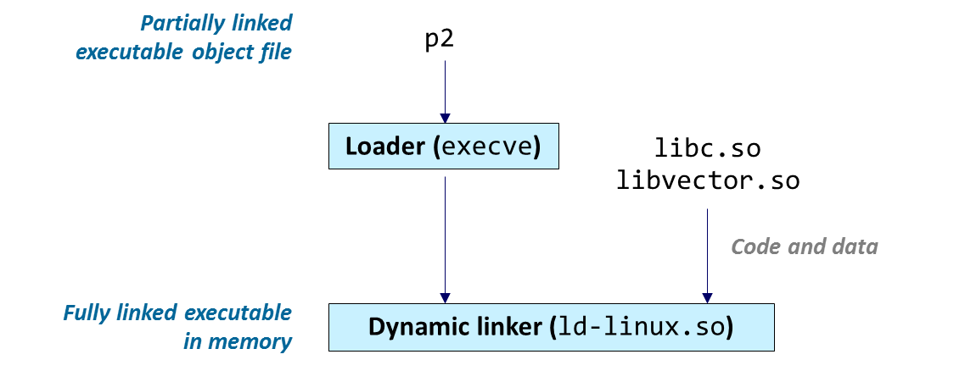
Dynamic Linking

Slide 15
Dynamic Linking
Shared libraries are only loaded when the process that uses them is created
Virtual addresses of shared libraries are not fixed
Some of the linking cannot be performed at link time (one-time operation) and must be performed at load time (every time the program is started)
Dynamic linker
Invoked by the loader
Relocates references to shared libraries during load time

Slide 16
Dynamic Linking at Load-time
main2.c
vector.h
$ gcc -shared -o libvector.so \
addvec.c mulvec.c
Translators
(cpp,cc1,as)
libc.so
libvector.so
Relocatable
object file
main2.o
Relocation and symbol table info
Linker (ld)
Partially linked
executable object file
p2
Loader (execve)
libc.so
libvector.so
Code and data
Fully linked executable
in memory
Dynamic linker (ld-linux.so)

Slide 17
Dynamic Linking at Load-time – Full Example
Shared library
void addvec(int *dst, int *src1, int *src2, int N) {
for (int i=0; i<N; i++) dst[i] = src1[i] + src2[i];
}
addvec.c
void mulvec(int *dst, int *src1, int *src2, int N) {
for (int i=0; i<N; i++) dst[i] = src1[i] * src2[i];
}
mulvec.c
// add N elements of vectors ‘src1’ and ‘src2’ and // place result in ‘dst’. void addvec(int *dst, int *src1, int *src2, int N);
// multiply N elements of vectors ‘src1’ and ‘src2’ // and place result in ‘dst’. void mulvec(int *dst, int *src1, int *src2, int N);
vector.h
$ gcc -shared -o libvector.so addvec.c mulvec.c

Slide 18
Dynamic Linking at Load-time – Full Example
Application using the vector library
#include <stdio.h>
#include <stdlib.h>
#include "vector.h"
void initvec(int *v, int N) { … }
void printvec(char *label, int *v, int N) { … }
int main(int argc, char *argv[]) {
int N = argc > 2 ? atoi(argv[1]) : 0;
if (N <= 0) N = 16;
int *a = malloc(N * sizeof(int));
int *b = malloc(N * sizeof(int));
int *c = malloc(N * sizeof(int));
if (!a || !b || !c) { … }
initvec(a, N); initvec(b, N);
printvec("a", a, N);
printvec("b", b, N);
addvec(c, a, b, N);
printvec("a+b", c, N);
mulvec(c, a, b, N);
printvec("a*b", c, N);
free(a); free(b); free(c);
return EXIT_SUCCESS;
}
$ gcc -Wall -g -o vectormath vectormath.c -L. -lvector
$ LD_LIBRARY_PATH=.:$LD_LIBRARY_PATH ./vectormath
a: 7 6 9 3 1 15 10 12 9 13 …
b: 12 2 4 8 11 8 7 13 6 10 …
a+b: 19 8 13 11 12 23 17 25 15 23 …
a*b: 84 12 36 24 11 120 70 156 54 130 …
Only specify the name of the library, not the filename of the file (-lvector, not -llibvector.so)!
LD_LIBRARY_PATH is an environment variable that tells the system where to look for libraries
Usually, the current directory ‘.’ is not included, so we temporarily add it to the system-wide path
We can also make the change permanent for the current shell, then can start vectormath directly
$ export LD_LIBRARY_PATH=.:$LD_LIBRARY_PATH $ ./vectormath
a: 7 6 9 3 1 15 10 12 9 13 …
b: 12 2 4 8 11 8 7 13 6 10 …
a+b: 19 8 13 11 12 23 17 25 15 23 …
a*b: 84 12 36 24 11 120 70 156 54 130 …
vectormath.c

Slide 19
Manually Loading Shared Libraries
Shared libraries can be loaded manually and at runtime
Plugin systems
Add new functionality
No need to have header files or shared library available at compile time
Resource constrained environments
Load only libraries that are currently in use
Hot patching
Allows updating of libraries without restarting a running application
Platform independence
Load platform-dependent libraries manually

Slide 20
Manually Loading Shared Libraries
Manually-loaded shared libraries must be linked “manually”
Load library
Obtain address of function
Call function
plus error checking!
void *handle = dlopen("./libvector.so", RTLD_LAZY);
void (*addvec)(int *, int *, int *, int);
addvec = dlsym(handle, "addvec");
addvec(x, y, z, 2);

Slide 21
Dynamic Linking at Run-Time – Full Example
Application loading the library at run time
…
#include <dlfcn.h>
int main(int argc, char *argv[]) { // // load shared library //
void *handle;
handle = dlopen("./libvector.so", RTLD_LAZY);
if (!handle) { … }
//
// obtain addresses of library functions
//
void (*addvec)(int*,int*,int*,int); void (*mulvec)(int*,int*,int*,int);
addvec = dlsym(handle, "addvec");
mulvec = dlsym(handle, "mulvec"); if (!addvec || !mulvec) { … }
int N = argc > 2 ? atoi(argv[1]) : 0;
…
addvec(c, a, b, N);
…
mulvec(c, a, b, N);
…
return EXIT_SUCCESS;
}
$ gcc -Wall -g -o vectormathrt vectormathrt.c -ldl
$ LD_LIBRARY_PATH=.:$LD_LIBRARY_PATH ./vectormathrt
a: 7 6 9 3 1 15 10 12 9 13 …
b: 12 2 4 8 11 8 7 13 6 10 …
a+b: 19 8 13 11 12 23 17 25 15 23 …
a*b: 84 12 36 24 11 120 70 156 54 130 …
We do not need to provide our shared library at link time
Instead, the system library for dynamic run-time linking, libdl.so, is included with -ldl
vectormathrt.c

Slide 22
Position Independent Code

Slide 23
Position Independent Code
A technique that uses only relative offsets to access objects (variables and code)
Makes the code independent from its final memory location
Allows shared libraries loaded at any available memory address
PIC does not require re-linking
Obviously, we cannot use absolute addresses to refer to objects
Useful for
Shared libraries (modern OSes use them in most cases)
Address Space Layout Randomization
Security
At-runtime dynamic loading

Slide 24
Position Independent Code
PIC uses only PC-relative offsets
This only works if the position of the code + data is constant!
Ensured by the linker ( .text, .rodata, .data, and .bss sections are moved together as a whole)
The address of a function in a shared library not known before loading
Dynamic linking is necessary
int global;
int main(int argc, char *argv[])
{
global = 7;
return 0;
}
Disassembly of section .text:
...
00001125 <main>:
1125: movl $0x7,0x2ee5(%rip) # 4014
112f: mov $0x0,%eax
1134: ret
Disassembly of section .bss:
...
00004014 <global>:
4014: 00 00

Slide 25
PIC and Shared Libraries
Global Offset Table (GOT) is in data section
Program Linkage Table (PLT) is in code section
GOT is patched by dynamic linker
Basic idea
…
call lib1func@plt
…
…
PLT[2](lib1func@plt):
jmp *GOT[4]
push function ID
jmp PLT[0]
…
GOT[4]:
<addr of lib1func>
lib1func: … ret

Slide 26
PIC and Shared Libraries
Lazy linking: first invocation
…
call lib1func@plt
…
1
GOT[1]:
<address of reloc entries>
GOT[2]:
<addr of dynamic linker>
…
GOT[4]:
<addr of push in PLT[2]>
PLT[0]:
push *GOT[1]
jmp *GOT[2]
…
PLT[2](lib1func@plt):
jmp *GOT[4]
push function ID
jmp PLT[0]
5
4
2
3
6
lib1func: … ret
resolver:
find the address of function with its ID
write it into the GOT entry (i.e., GOT[4])
jump to function
7
6

Slide 27
PIC and Shared Libraries
Lazy linking: 2nd and further invocations
…
call lib1func@plt
…
1
PLT[0]:
push *GOT[1]
jmp *GOT[2]
…
PLT[2](lib1func@plt):
jmp *GOT[4]
push function ID
jmp PLT[0]
GOT[2]:
<addr of resolver>
…
GOT[4]:
<addr of lib1func>
2
3
lib1func: … ret
resolver:
find address of function with ID
write address into corresp. GOT entry
jump to function
4

Slide 28
Library Interpositioning
$ LD_PRELOAD=./mymalloc.so ./hellor
malloc(10) = 0x501010
free(0x501010)
hello, world
Case Study

Slide 29
Case Study: Library Interpositioning
Library interpositioning : powerful linking technique that allows programmers to intercept calls to arbitrary functions
Interpositioning can occur at:
Compile time: When the source code is compiled
Link time: When the relocatable object files are statically linked to form an executable object file
Load/run time: When an executable object file is loaded into memory, dynamically linked, and then executed.

Slide 30
Some Interpositioning Applications
Security
Confinement (sandboxing)
Interpose calls to libc functions.
Behind the scenes encryption
Automatically encrypt otherwise unencrypted network connections.
Monitoring and Profiling
Count number of calls to functions
Characterize call sites and arguments to functions
malloc tracing
Detecting memory leaks
Generating address traces

Slide 31
Example Program
#include <stdio.h>
#include <stdlib.h>
#include "malloc.h"
int main()
{
free(malloc(10));
printf("hello, world\n");
return EXIT_SUCCESS;
}
hello.c
Goal: trace the addresses and sizes of the allocated and freed blocks, without modifying the source code.
Three solutions: interpose on the lib malloc and free functions at compile time, link time, and load/run time.

Slide 32
Interpositioning Techniques
Compile Time
Calls to malloc/free get macro-expanded into calls to mymalloc/myfree
Requires: source code
Link Time
Use linker trick to rename function names during linking
malloc → __wrap_malloc
__real_malloc → malloc
Requires: (prepared) relocatable object files
Load/Run-Time
Implement custom version of malloc/free in a shared library and link calls to that library using interpositioning
Requires: nothing, works with any dynamically linked binary

Slide 33
Compile-time Interpositioning
#ifdef COMPILETIME
// Compile-time interposition of malloc and free using C
// preprocessor. A local malloc.h file defines malloc (free)
// as wrappers mymalloc (myfree) respectively.
#include <stdio.h>
#include <malloc.h>
//
// mymalloc - malloc wrapper function
//
void *mymalloc(size_t size, char *file, int line)
{
void *ptr = malloc(size);
printf("%s:%d: malloc(%d)=%p\n", file, line, (int)size, ptr);
return ptr;
}
#endif
mymalloc.c

Slide 34
Compile-time Interpositioning
#define malloc(size) mymalloc(size, __FILE__, __LINE__ )
#define free(ptr) myfree(ptr, __FILE__, __LINE__ )
void *mymalloc(size_t size, char *file, int line);
void myfree(void *ptr, char *file, int line);
malloc.h
$ make helloc
gcc -Wall -DCOMPILETIME -c mymalloc.c
gcc -Wall -I. -o helloc hello.c mymalloc.o
$ make runc
./helloc
hello.c:7: malloc(10)=0x501010
hello.c:7: free(0x501010)
hello, world

Slide 35
Link-time Interpositioning
#ifdef LINKTIME
// Link-time interposition of malloc and free using // the static linker's (ld) "--wrap symbol" flag.
#include <stdio.h>
void *__real_malloc(size_t size);
void __real_free(void *ptr);
//
// __wrap_malloc - malloc wrapper function
//
void *__wrap_malloc(size_t size)
{
void *ptr = __real_malloc(size);
printf("malloc(%d) = %p\n", (int)size, ptr);
return ptr;
}
#endif
mymalloc.c

Slide 36
Link-time Interpositioning
$ make hellol
gcc -Wall -DLINKTIME -c mymalloc.c
gcc -Wall -Wl,--wrap,malloc -Wl,--wrap,free \
-o hellol hello.c mymalloc.o
$ make runl
./hellol
malloc(10) = 0x501010
free(0x501010)
hello, world
The “-Wl” flag passes argument to linker
Telling linker “--wrap,malloc ” tells it to resolve references in a special way:
Refs to malloc should be resolved as __wrap_malloc
Refs to __real_malloc should be resolved as malloc

Slide 37
Load/Run-time Interpositioning
#ifdef RUNTIME
// Run-time interposition of malloc and free based on
// dynamic linker's (ld-linux.so) LD_PRELOAD mechanism
#define _GNU_SOURCE
#include <stdio.h>
#include <stdlib.h>
#include <dlfcn.h>
void *malloc(size_t size) {
static void *(*mallocp)(size_t size) = NULL;
char *error;
void *ptr;
// get address of original libc malloc
if (!mallocp) {
mallocp = dlsym(RTLD_NEXT, "malloc");
if ((error = dlerror()) != NULL) {
fputs(error, stderr);
exit(EXIT_FAILURE);
}
}
ptr = mallocp(size);
printf("malloc(%d) = %p\n", (int)size, ptr);
return ptr;
}
#endif
mymalloc.c

Slide 38
Load/Run-time Interpositioning
The LD_PRELOAD environment variable tells the dynamic linker to resolve unresolved refs (e.g., to malloc) by looking in libdl.so and mymalloc.so first.
libdl.so necessary to resolve references to the dlopen functions.
$ make hellor
gcc -Wall -DRUNTIME -shared -fPIC -o mymalloc.so mymalloc.c -ldl
gcc -Wall -o hellor hello.c
$ make runr
(LD_PRELOAD="/usr/lib64/libdl.so ./mymalloc.so" ./hellor)
malloc(10) = 0x501010
free(0x501010)
hello, world

Slide 39
How does it work?
Symbols resolved at load time
LD_LIBRARY_PATH indicates where the loader searches for libraries
Step 1: load binary and required libraries
Step 2: resolve symbols
main() {
malloc(…)
}
…
malloc(…);
free(…);
…
main
libc

Slide 40
How does it work?
Symbols resolved at load time
LD_LIBRARY_PATH indicates where the loader searches for libraries
LD_PRELOAD takes precedence over LD_LIBRARY_PATH
Step 1: load binary and required libraries
Step 2: resolve symbols
main() {
malloc(…)
}
malloc() {
dlsym(…, “malloc”)
}
…
malloc(…);
free(…);
…
main
mymalloc
libc
can retrieve original
malloc symbol using
dlsym(RTLD_NEXT, …)
malloc() in myalloc is
found first and linked to

Slide 41
Summary
Summary
-------------
-------------
-------------
-------------
-------------
-----

Slide 42
Summary
Libraries
“packages” of functions commonly used together
Static Libraries
“concatenation” of relocatable object files into an archive (hence *.a)
at link time, “copy-paste” referenced object files into executable
disadvantages: code size increase, library updates requires re-linking
Dynamic (Shared) Libraries
library linked to executable at load/run-time
allows sharing of code between different processes
no recompilation necessary
Library Interpositioning
intercept calls to system libraries
a potential security risk

